Slide 1
ANALYSIS OF AIRCRAFTS FOR COMMERCIAL AND PRIVATE ENTERPRISES By Patience Severino
Summary
Analysis of The National Transportation Safety Board that includes accidents from 1962 to 2023 that would be useful in purchasing and operation of both private and commercial aircrafts.

Slide 2
Outline
Business understanding
Data Understanding
Results
Conclusion

Slide 3
Business Understanding
Problem statement
Since we want to diversify our business, we are interested in buying and running aircraft for both private and commercial companies, but we are unaware of the possible hazards associated with them. To begin this new business venture, we need to identifying which planes pose the least risk to the organization. Through our analysis of the data we will be able to come to a conclusion on the best aircraft models that we will settle on for our business.

Slide 4
Objectives
Our main objectives include:
Determine aircrafts models that got involved in accidents.
Determine aircrafts that have low casuality levels.
Determine aircrafts that are low risk to the business.
Figuring out which engines are less likely to be involved in accidents.

Slide 5
Research questions
What is the most preferred aircraft model?
Which aircraft model has minimal casualties in case of accidents?
Which engine types are less likely to be involved in accidents?

Slide 6
Success criteria
Finding aircrafts that pose low risks
Finding aircrafts that would be a perfect fit for the company.

Slide 7
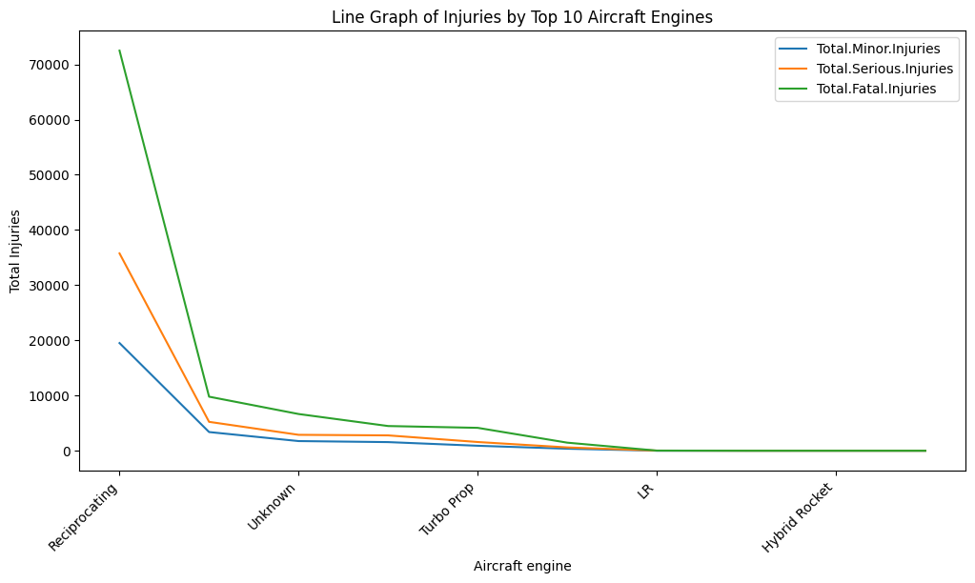
Visualizations The graph below shows the total injuries incurred by different aircraft models

Slide 8
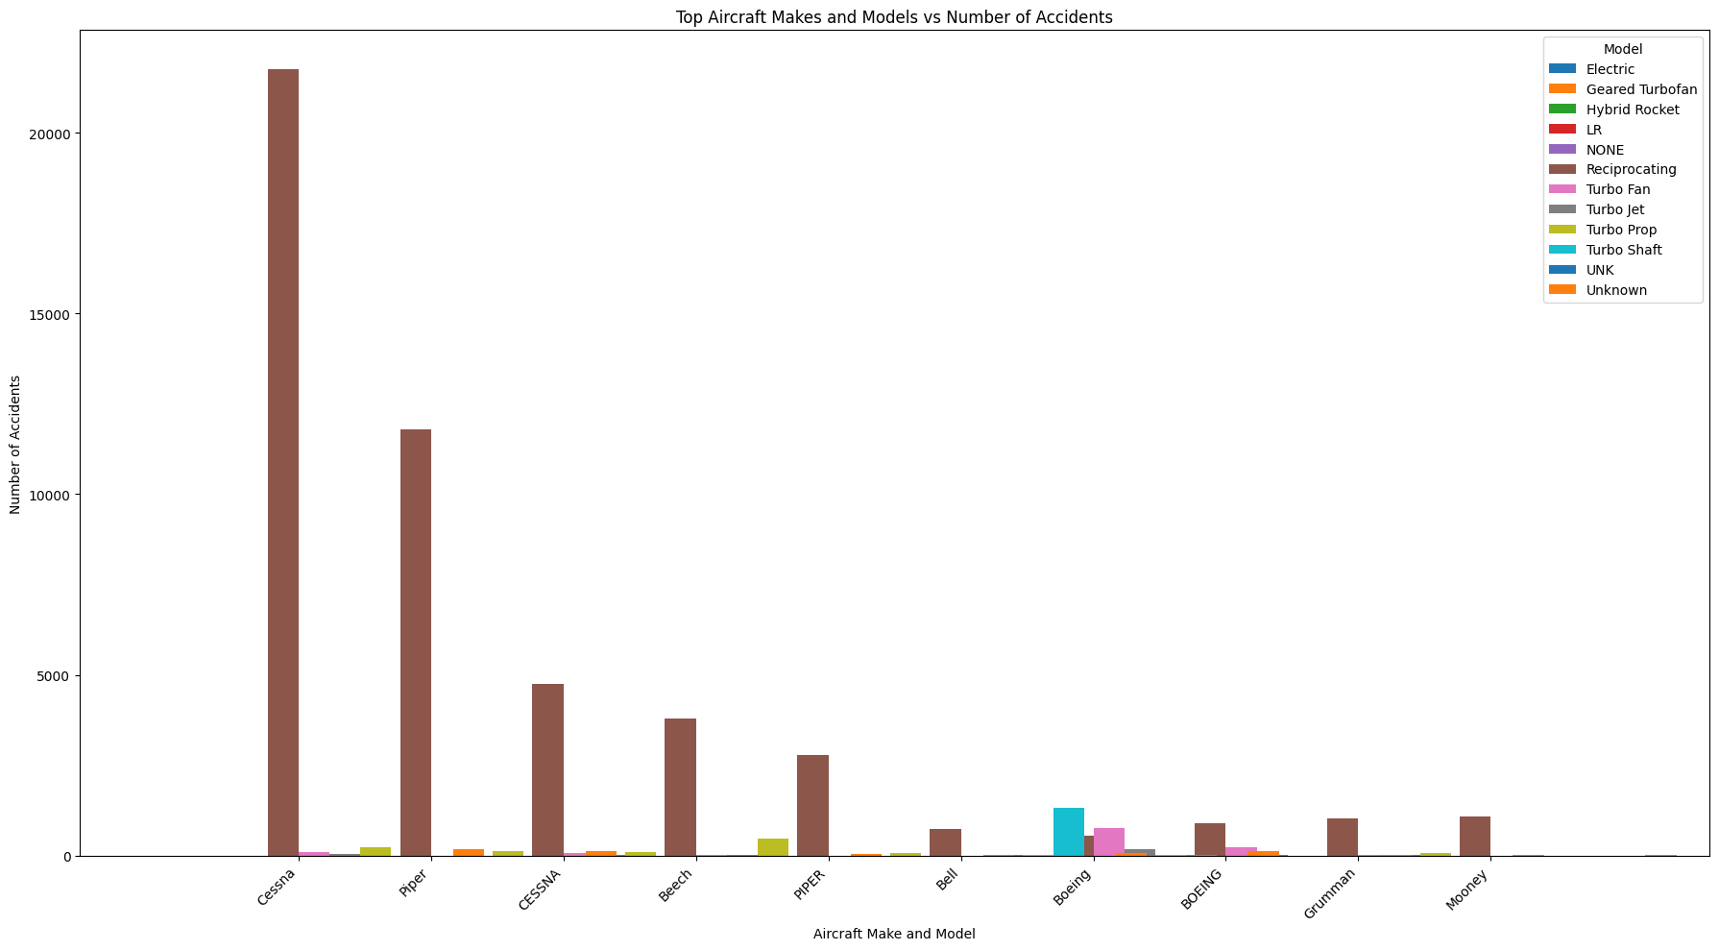
The graph below shows the number of accidents that occurred against the aircraft models and engines

Slide 9
Conclusions
Certain aircraft models are involved in a much larger number of accidents than others.
Some aircraft models are more vulnerable to particular types of damage, such as structural damage, engine failure, or landing gear problems, according to the examination of aircraft damage types
Selecting models with superior safety features can lower the chance of damage and accidents

Slide 10
Recommendations
Purchasing aircraft models with a solid safety record and consistently low damage rates is a wise investment
Multi-engine aircraft have a reduced incidence of accidents and generally have superior safety features
Compiling information on aircraft performance on a regular basis

Slide 11
Thank you! Email:patienceseverino36@gmail.com

